Slide 1
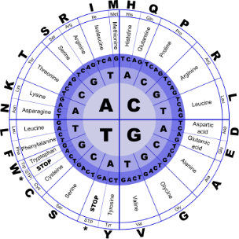
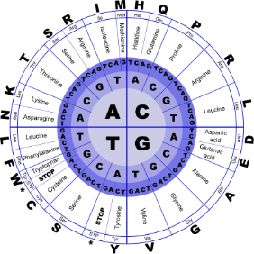


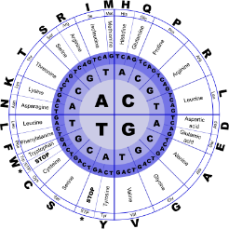
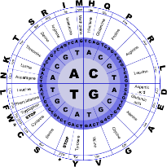
Fundamentals of Programming II
Decisions

Slide 2
Relational Operators
Used to compare numeric values to determine relative order
Operators:
> | Greater than
< | Less than
>= | Greater than or equal to
<= | Less than or equal to
== | Equal to
!= | Not equal to

Slide 3
Relational Expressions
Relational expressions are Boolean (i.e., evaluate to true or false)
Examples:
12 > 5 is true
7 <= 5 is false
if x is 10, then
x == 10 is true,
x <= 8 is false,
x != 8 is true, and
x == 8 is false

Slide 4
Relational Expressions
Can be assigned to a variable
bool result = (x <= y);
Assigns 0 for false, 1 for true
Do not confuse = (assignment) and == (equal to)

Slide 5
The if Statement
Supports the use of a decision structure
Allows statements to be conditionally executed or skipped over
Models the way we mentally evaluate situations
“If it is cold outside,
wear a coat and wear a hat.”

Slide 6
The if Statement
if (condition)
{
statement1;
statement2;
…
statementn;
}
The block inside the braces is called the body
of the if statement. If there is only 1 statement
in the body, the { } may be omitted.
No ; goes here
; goes here

Slide 7
The if Statement
If (condition) is true, then the statement(s) in the body are executed.
If (condition) is false, then the statement(s) are skipped.
condition
true
false
1 or more
statements

Slide 8
The if Statement
if (score >= 60)
cout << "You passed." << endl;
if (score >= 90)
{
grade = 'A';
cout << "Wonderful job!" << endl;
}

Slide 9
The if Statement
if is a keyword. It must be lowercase
(condition)must be in ( )
Do not place ; after (condition)
Don't forget the { } around a multi-statement body

Slide 10
The if Statement
Place each statement; on a separate line after (condition)
Indent each statement in the body
When using { and } around the body, put { and } on lines by themselves

Slide 11
What is true and false?
An expression whose value is 0 is considered false.
An expression whose value is non-zero is considered true.
An expression need not be a comparison – it can be a single variable or a mathematical expression.

Slide 12
Flag
A variable that signals a condition
Usually implemented as a bool
Meaning:
true: the condition exists
false: the condition does not exist
The flag value can be both set and tested with if statements

Slide 13
Flag
Example:
bool validMonths = true;
…
if (months < 0)
validMonths = false;
…
if (validMonths)
moPayment = total / months;

Slide 14
Integer Flags
Integer variables can be used as flags
Remember that 0 means false, any other value means true
int allDone = 0; // set to false
…
if (count > MAX_STUDENTS)
allDone = 1; // set to true
…
if (allDone)
cout << "Task finished";

Slide 15
The if/else Statement
Allows a choice between statements depending on whether (condition) is true or false
Format: if (condition)
{
statement set 1;
}
else
{
statement set 2;
}

Slide 16
The if/else Statement
If (condition) is true, statement set 1 is executed and statement set 2 is skipped.
If (condition) is false, statement set 1 is skipped and statement set 2 is executed.
true
false
condition
statement set 1
statement
set 2

Slide 17
The if/else Statement
if (score >= 60)
cout << "You passed.\n";
else
cout << "You did not pass.\n";
if (intRate > 0)
{ interest = loanAmt * intRate;
cout << interest;
}
else
cout << "You owe no interest.\n";

Slide 18
floating-point numbers
It is difficult to test for equality when working with floating point numbers.
It is better to use
greater than, less than tests, or
test to see if value is very close to a given value

Slide 19
The if/else if Statement
Chain of if statements that test in order until one is found to be true
Also models thought processes
“If it is raining, take an umbrella,
else, if it is windy, take a hat,
else, if it is sunny, take sunglasses.”

Slide 20
The if/else if Statement
if (condition 1)
{ statement set 1;
}
else if (condition 2)
{ statement set 2;
}
…
else if (condition n)
{ statement set n;
}

Slide 21
Using a Trailing else
Used with if/else if statement when all of the conditions are false
Provides a default statement or action that is performed when none of the conditions is true
Can be used to catch invalid values or handle other exceptional situations

Slide 22
if/else if with Trailing else
if (age >= 21)
cout << "Adult";
else if (age >= 13)
cout << "Teen";
else if (age >= 2)
cout << "Child";
else
cout << "Baby";

Slide 23
Menu-Driven Program
Menu: list of choices presented to the user on the computer screen
Menu-driven program: program execution controlled by user selecting from a list of actions
Menu can be implemented using if/else if statements

Slide 24
Nested if Statements
An if statement that is part of the if or else part of another if statement
Can be used to evaluate > 1 data item or condition
if (score < 100)
{
if (score > 90)
grade = 'A';
}

Slide 25
Nested if Statements
An else matches the nearest previous if that does not have an else
if (score < 100)
if (score > 90)
grade = 'A';
else ... // goes with second if,
// not first one
Proper indentation aids comprehension

Slide 26
Logical Precedence
Highest !
&&
Lowest ||
Example:
(2 < 3) || (5 > 6) && (7 > 8)
is true because AND is evaluated before OR

Slide 27
Logical Precedence
Highest
arithmetic operators
relational operators
Lowest
logical operators
Example:
8 < 2 + 7 || 5 == 6 is true

Slide 28
Numeric Ranges with Logical Operators
Used to test if a value is within a range
if (grade >= 0 && grade <= 100)
cout << "Valid grade";
Can also test if a value lies outside a range
if (grade <= 0 || grade >= 100)
cout << "Invalid grade";
Cannot use mathematical notation
if (0 <= grade <= 100) //Doesn’t
//work!

Slide 29
Validating User Input
Input validation: inspecting input data to determine if it is acceptable
Want to avoid accepting bad input
Can perform various tests
Range
Reasonableness
Valid menu choice
Zero as a divisor

Slide 30
Blocks and Scope
Scope of a variable is the block in which it is defined, from the point of definition to the end of the block
Variables are usually defined at the beginning of a function
They may instead be defined close to the place where they are first used

Slide 31
Blocks and Scope
Variables defined inside { } have local or block scope
When in a block that is nested inside another block, you can define variables with the same name as in the outer block.
When the program is executing in the inner block, the outer definition is not available
This is generally not a good idea

Slide 32
Characters and Strings
Can use relational operators with characters and string objects
if (menuChoice == 'A')
if (firstName == "Beth")
Comparing characters is really comparing ASCII values of characters
Comparing string objects is comparing the ASCII values of the characters in the strings. Comparison is character-by-character
Cannot compare C-style strings with relational operators

Slide 33
Testing Characters
require cctype header file
FUNCTION | MEANING
isalpha | true if arg. is a letter, false otherwise
isalnum | true if arg. is a letter or digit, false otherwise
isdigit | true if arg. is a digit 0-9, false otherwise
islower | true if arg. is lowercase letter, false otherwise

Slide 34
Testing Characters
require cctype header file
FUNCTION | MEANING
isprint | true if arg. is a printable character, false otherwise
ispunct | true if arg. is a punctuation character, false otherwise
isupper | true if arg. is an uppercase letter, false otherwise
isspace | true if arg. is a whitespace character, false otherwise

Slide 35
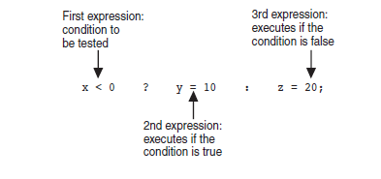
The Conditional Operator
Can use to create short if/else statements
Format: expr ? expr : expr;

Slide 36
The switch Statement
Used to select among statements from several alternatives
May sometimes be used instead of if/else if statements

Slide 37
The switch Statement
switch (IntExpression)
{
case exp1: statement set 1;
case exp2: statement set 2;
...
case expn: statement set n;
default: statement set n+1;
}

Slide 38
The switch Statement
IntExpression must be a char or an integer variable or an expression that evaluates to an integer value
exp1 through expn must be constant integer type expressions and must be unique in the switch statement
default is optional but recommended

Slide 39
The switch Statement
IntExpression is evaluated
The value of intExpression is compared against exp1 through expn.
If IntExpression matches value expi, the program branches to the statement(s) following expi and continues to the end of the switch
If no matching value is found, the program branches to the statement after default:

Slide 40
The break Statement
Used to stop execution in the current block
Also used to exit a switch statement
Useful to execute a single case statement without executing statements following it

Slide 41
The break Statement
switch (gender)
{
case 'f': cout << "female";
break;
case 'm': cout << "male";
break;
default : cout << "invalid gender";
}

Slide 42
Enumerated Data Types
Data type created by programmer
Contains a set of named constant integers
Format:
enum name {val1, val2, … valn};
Examples:
enum Fruit {apple, grape, orange};
enum Days {Mon, Tue, Wed, Thur, Fri};

Slide 43
Enumerated Data Types
To define variables, use the enumerated data type name
Fruit snack;
Days workDay, vacationDay;
Variable may contain any valid value for the data type
snack = orange; // no quotes
if (workDay == Wed) // none here

Slide 44
Enumerated Data Types
Enumerated data type values are associated with integers, starting at 0
enum Fruit {apple, grape, orange};
Can override default association
enum Fruit {apple = 2, grape = 4, orange = 5}
0
1
2

Slide 45
Enumerated Data Types
Enumerated data types improve the readability of a program
Enumerated variables can not be used with input statements, such as cin
Will not display the name associated with the value of an enumerated data type if used with cout

